Slide 1
IHE China Connectathon 集成模式介绍

Slide 2
内容
SWF (预约工作流)
PIR (患者信息整合)
CPI（影像一致性显示）
PDI (移动式数据图像)

Slide 3
几个概念
Integration Profile (集成模式)
每个Profile是医疗信息系统的一个功能单元，它将
一组相关的角色组织在一起,定义它们需要完成的事
务,以完成医疗系统某种特定的需求.
SWF
PIR
CPI
PDI

Slide 4
几个概念
Actor (角色)
用来产生，管理或者操作和医疗企业活动相关的
信息的应用系统或模块 。
MOD （成像设备）
Print Composer （打印设备）
IM （图像管理)

Slide 5
几个概念
Transaction (事务)
事务是在角色之间所进行的操作，事务通过相关的
标准协议（如DICOM,HL7）进行医疗信息的交换 。
Patient Registration （患者注册）
Query Modality Worklist （查询设备工作列表）
Modality Image Stored （设备图像保存)

Slide 6

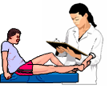






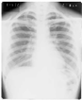
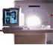
IHE Radiology Workflow
ADT (Registration)
report
Report
Repository
Image
Display
Film
Lightbox
Order Placer
Image Manager
& Archive
Film
Folder
Acquisition Modality
Order Filler
acquisition completed
acquisition in-progress
Print Server
acquisition completed
images printed
Modality

Slide 7
SWF - 预约工作流
定义了从预约检查到图像获取、图像显示以及诊断的
整个流程。是放射科的基本工作流程.
检查预约
检查执行
图像显示

Slide 8
ADT
Pt. Registration [RAD-1]
Patient Update [RAD-12]
Pt. Registration [RAD-1]
Patient Update [RAD-12]
Placer Order Management [RAD-2]
Filler Order Management [RAD-3]
DSS/Order Filler
Order Placer
Modality PS in Progress [RAD-6]
Modality PS Completed [RAD-7]
Creator PS in Progress [RAD-20]
Creator PS Completed [RAD-21]
Procedure Scheduled [RAD-4]
Procedure Update [RAD-13]
Performed Work Status Update [RAD-42]
Performed Work Status Update [RAD-42]
Image
Display
Evidence Creator
Query Images [RAD-14]
Retrieve Images [RAD-16]
Creator PS in Progress [RAD-20]
Creator PS Completed [RAD-21]
Storage
Commitment
[RAD-10]
Creator
Image
Stored [RAD-18]
Performed Procedure
Step Manager
Image
Manager
Image
Archive
Modality PS in Progress [RAD-6]
Modality PS Completed [RAD-7]
Creator PS in Progress [RAD-20]
Creator PS Completed [RAD-21]
Storage
Commitment
[RAD-10]
Modality Image
Stored
[RAD-8]
Modality PS in Progress [RAD-6]
Modality PS Completed [RAD-7]
Acquisition
Modality
Query Modality Worklist [RAD-5]

Slide 9
角色介绍
ADT:管理,维护患者的统计信息,以及入院,出院,转院等信息.
Order Placer:医院或者企业级的应用系统,根据医嘱生成检查请求并发送给相应的科室.
Order Filler:科室级的应用系统,根据从OP发来的或者本系统生成的请求提供某种特定医疗服务.
Image Manager:图像管理系统,负责保存和管理系统生成的图像信息.
Image Archive:图像存储系统,负责长期保存图像.

Slide 10
角色介绍
MOD:图像采集设备.负责采集医疗图像并将其发送给IM保存或者打印机打印.
PPSM:检查状态管理系统.负责将从设备接收的检查过程状态信息转发给OF和IM.
EC:二次检测/诊断系统.负责对采集设备生成的图像进行二次处理,生成某些证据帮助医生进行诊断.
ID:图像显示系统.负责显示原始图像,表现状态(Presentation State),关键图像注释以及二次处理的证据信息.

Slide 11
检查预约
预约工作流程

Slide 12
检查预约
Order
Placer
DSS
Order Filler
Image
Manager
Acquisition
Modality
ADT
Register/Admin Patient
Patient Registration [RAD-1]
Create Order
Placer Order Management -New [RAD-2]
Schedule Procedure and assign protocol
Procedure Scheduled [RAD-4]
Query Modality Worklist [RAD-5]

Slide 13
患者登记－Patient Registration
使用HL7 ADT消息传递信息
ADT^A01：住院患者登记
ADT^A04：门诊患者登记
ADT^A05：住院患者提前登记
ADT^A11：取消住院或门诊患者登记
ADT^A38：取消住院患者提前登记

Slide 14
生成指令管理－Placer Order Management
使用HL7 ORM^O01消息传递指令信息
由检查指令发出者（Order Placer）根据医嘱生成检查指令，发送给指令执行者（Order Filler）。
指令发出者也可以取消或者中断之前发出的检查指令
发出新的检查指令 ORC-1: NW
取消检查指令 ORC-1: CA
中断检查指令 ORC-1: DC

Slide 15
检查过程预约－Procedure Scheduled
由检查指令执行者（Order Filler）生成根据医嘱生成检查指令，发送给图像管理者（Image Manager）。
使用HL7 ORM^O01消息传递指令信息
预定新的检查指令
ORC-1: NW
ORC-5: SC

Slide 16
查询设备工作列表－Query Modality Worklist
由检查指令执行者（Order Filler）生成设备工作列表。
设备（Modality）通过DICOM 查询服务获取工作列表。
基于患者的查询 (Patient Based Query)
患者姓名(0010，0010)
患者ID(0010，0020)
访问号(Accession Number)(0008，0050)
请求过程ID(Requested Procedure ID)(0040，1001)
宽泛查询(Broad Query)
预约的过程开始时间(Scheduled Procedure Step Start Time) (0040，0002)
设备(0008，0060)
站点应用程序名称(Scheduled Station AE Title)(0040，0001)

Slide 17
消息交换过程
Order
Placer
Order
Placer
DSS
Order Filler
Image
Manager
Modality
ADT^*
*= A01, A04, A05,
A11, A38
ACK
ADT^*
ACK
ORM^O01
ORR^O02
ORM^O01
ORR^O02
C-FIND-RQ
C-FIND-RSP

Slide 18
检查执行
预约工作流程

Slide 19
Order
Placer
DSS
Order Filler
Image Manager
Image Archive
Acquisition
Modality
Modality Procedure Step In Progress [RAD-6]
Modality Procedure Step In Progress [RAD-6]
Start Acquisition
Perform Acquisition
Modality Image Stored [RAD-8]
Modality Presentation State Stored [RAD-9]
Storage Commitment [RAD-10]
Modality Procedure Step Completed [RAD-7]
Modality Procedure Step Completed [RAD-7]
Filler Order Management
[RAD-3]

Slide 20
设备检查进行中－Modality Procedure Step In Progress
由设备（Modality）通知执行过程步骤管理者（PPSM）检查已经开始
PPSM进而通知图像管理者(IM)/检查执行者(OF)检查已经开始
一般地，PPSM会和IM或者OF集成在一起
使用DICOM N-CREATE实现初始化检查步骤

Slide 21
设备图像保存－Modality Image Stored
由设备（Modality）将获取的图像发送给图像管理者（IM）
通过DICOM C-STORE 服务完成图像传输
图像管理者必须支持设备生成的SOP类

Slide 22
设备检查完成－Modality Procedure Step Completed
由设备（Modality）通知执行过程步骤管理者（PPSM）检查已经完成
PPSM进而通知图像管理者(IM)/检查执行者(OF)检查已经完成
一般地，PPSM会和IM或者OF集成在一起
使用DICOM N-SET将检查步骤状态设为“完成”

Slide 23
图像保存确认－Storage Commitment
由设备（Modality）通知图像管理者（IM）将图像的所有权从设备转移到图像管理者
在之前的设备图像保存成功后进行此事务
使用DICOM N-ACTION和N-EVENT-REPORT完成所有权的转移
在这之后，设备可以清除本机的图像信息，图像管理者(IM)负责维护图像

Slide 24
检查执行管理－Filler Order Management
由检查指令执行者（Order Filler）生成,取消或者更新检查状态并通知检查指令发出者 （Order Placer）.
使用HL7 ORM^O01消息传递指令信息
ORC-1=SN (新的检查指令生成)
ORC-1=SC (检查状态更新)
ORC-5=CM: 检查指令完成
ORC-5=OD: 检查指令中断
ORC-5=IP: 检查指令正在进行中
ORC-1=OC (检查取消)

Slide 25
消息交换过程
Order
Placer
DSS
Order Filler
Image Manager
/PPSM
Modality
N-CREATE-RQ
N-CREATE-RQ
N-CREATE-RSP
N-CREATE-RSP
C-STORE-RQ
C-STORE-RSP
N-ACTION-RQ
N-ACTION-RSP
N-EVENT-REPORT-RQ
N-EVENT-REPORT-RSP
N-SET-RQ
N-SET-RQ
ORM^O01
N-SET-RSP
N-SET-RSP
ORR^O02

Slide 26
患者信息更新
信息修改
检查指令(Order Entry)输入前修改患者信息
检查指令(Order Entry)输入后修改患者信息
检查过程预约(Procedure Schedule)后修改患者信息
指令信息更新
指令发出者(Order Placer)修改指令信息
指令执行者(Order Filler)修改指令信息

Slide 27
检查指令(Order Entry)输入前修改患者信息
Order
Placer
DSS
Order Filler
Image
Manager
Acquisition
Modality
ADT
Register/Admin Patient
Patient Registration [RAD-1]
Modify Patient
Patient Update [RAD-12]
Creator Order
Placer Order Management-New [RAD-2]

Slide 28
消息交换过程
Order
Placer
DSS/
Order Filler
ADT
ADT^*
*= A01, A04, A05,
A11, A38
ACK
ADT^*
ACK
ADT^*
*= A02, A03, A06,
A07, A08, A40
ACK
ADT^*
ACK
ORM^O01
ORR^O02

Slide 29
检查指令(Order Entry)输入后修改患者信息
Order
Placer
DSS
Order Filler
Image
Manager
Acquisition
Modality
ADT
Register/Admin Patient
Patient Registration [RAD-1]
Creator Order
Placer Order Management-New [RAD-2]
Modify Patient
Patient Update [RAD-12]

Slide 30
消息交换过程
Order
Placer
DSS/
Order Filler
ADT
ADT^*
*= A01, A04, A05,
A11, A38
ACK
ADT^*
ACK
ORM^O01
ORR^O02
ADT^*
*= A02, A03, A06,
A07, A08, A40
ACK
ADT^*
ACK

Slide 31
检查过程预约后修改患者信息
Order
Placer
DSS
Order Filler
Image
Manager
Acquisition
Modality
ADT
Register/Admin Patient
Patient Registration [RAD-1]
Creator Order
Placer Order Management-New [RAD-2]
Schedule Procedure and /or assign protocel
Procedure Scheduled [RAD-4]
Query Modality Worklist [RAD-5]
Modify Patient
Patient Update [RAD-12]

Slide 32
消息交换过程
Order
Placer
DSS
Order Filler
Image
Manager
Acquisition
Modality
ADT
ADT^*
ADT^*
*= A01, A04, A05,
A11, A38
ORM^O01
ORM^O01
C-FIND
ADT^*
ADT^*
*= A02, A03, A06,
A07, A08, A40

Slide 33
指令发出者(Order Placer) 替换检查指令
Order
Placer
DSS
Order Filler
Image
Manager
Acquisition
Modality
ADT
Cancel Order
Placer Order Management－Cancel [RAD-2]
Procedure Update [RAD-13]
Query Modality Worklist [RAD-5]
Create Order
Placer Order Management－New [RAD-2]
Procedure Scheduled [RAD-4]
Query Modality Worklist [RAD-5]

Slide 34
消息交换过程
Order
Placer
DSS
Order Filler
Image
Manager
Acquisition
Modality
ORM^O01
ORM^O01
Order Cancelled
Order Cancelled
C-FIND
ORM^O01
ORM^O01
New
Order
Created
New
Order
Created
C-FIND

Slide 35
指令执行者(Order Filler)修改指令信息
Order
Placer
DSS
Order Filler
Image
Manager
Acquisition
Modality
ADT
Order Cancelled
Filler Order Management－Cancel [RAD-3]
Procedure Update [RAD-13]
Query Modality Worklist [RAD-5]
Create Order
Filler Order Management－New [RAD-3]
Procedure Scheduled [RAD-4]
Query Modality Worklist [RAD-5]

Slide 36
消息交换过程
Order
Placer
DSS
Order Filler
Image
Manager
Acquisition
Modality
ORM^O01
ORM^O01
Order Cancelled
Order Cancelled
C-FIND
ORM^O01
ORM^O01
New
Order
Created
New
Order
Created
C-FIND

Slide 37
检查过程更新－Procedure Update
由检查指令执行者（Order Filler）通知图像管理者
（Image Manager）更新之前的检查指令。
使用HL7 ORM^O01消息传递指令信息
更新检查指令控制
ORC-1 | ORC-5 | 指令状态
CA | CA | 取消检查指令
DC | CA | 中断检查指令
XO | SC | 更新仍处于预定或进行中状态的指令
XO | CM | 更新已经完成的指令

Slide 38
图像查看
预约工作流程

Slide 39
图像获取,查看
Image
Manager
Image
Display
Query Images[RAD-14]
Retrieve Images[RAD-14]
Display Image

Slide 40
消息交换过程
Image Manager
Image Display
C-FIND-RQ
C-FIND-RSP
C-MOVE-RQ
C-STORE-RQ
C-STORE-RSP
C-MOVE-RSP

Slide 41
Actors | Transactions
ADT Patient Registration | Patient Registration [RAD-1] Patient Update [RAD-12]
Order Placer | Patient Registration [RAD-1] Patient Update [RAD-12] Placer Order Management [RAD-2] Filler Order Management [RAD-3]
DSS / Order Filler | Patient Registration [RAD-1] Patient Update [RAD-12] Placer Order Management [RAD-2] Filler Order Management [RAD-3] Procedure Scheduled [RAD-4] Query Modality Worklist [RAD-5] Modality Procedure Step In Progress [RAD-6] Modality Process Step Complete [RAD-7] Creator Procedure Step In Progress [RAD-20] Creator Process Step Complete [RAD-21] Procedure Update [RAD-13]
Acquisition Modality | Modality Procedure Step In Progress [RAD-6] Modality Process Step Complete [RAD-7] Modality Image Stored [RAD-8] Storage Commitment [RAD-10] Query Modality Worklist [RAD-5]
Image Manager / Image Archive | Procedure Scheduled [RAD-4] Query Modality Worklist [RAD-5] Modality Procedure Step In Progress [RAD-6] Modality Process Step Complete [RAD-7] Procedure Update [RAD-13] Creator Procedure Step In Progress [RAD-20] Creator Process Step Complete [RAD-21] Query Image [RAD-14] Retrieve Image [RAD-16] Creator Image Stored [RAD-18] Modality Image Stored [RAD-8] Image Availability Query [RAD-11]
Performed Procedure Step Manager | Modality Process Step Complete [RAD-7] Procedure Update [RAD-13] Creator Procedure Step In Progress [RAD-20] Creator Process Step Complete [RAD-21]
Image Display | Query Image [RAD-14] Retrieve Image [RAD-16]
Evidence Creator | Creator Image Stored [RAD-18] Storage Commitment [RAD-10]

Slide 42
PIR – 患者信息整合
定义了当患者信息不匹配或者发生错误时如何将正确的
和错误的患者信息整合在一起形成正确完整的患者记录。
未经确认的患者
患者信息在检查之前更新
患者信息在检查之后更新

Slide 43
ADT
Order Placer
Patient Update [RAD-12]
Patient Update [RAD-12]
DSS/Order Filler
Modality PS in Progress [RAD-6]
Modality PS Completed [RAD-7]
Patient Update [RAD-12]
Procedure Update [RAD-13]
Image Available Query [RAD-11]
Patient Update [RAD-12]
Procedure Update [RAD-13]
Report
Manager
Query Reporting Worklist [RAD-46]
Query Reports [RAD-26]
Retrieve Report [RAD-27]
Performed
Procedure
Step Manager
Report Creator/
Report Reader
Image
Manager
Image
Archive
Modality PS in Progress [RAD-6]
Modality PS Completed [RAD-7]
Query Images [RAD-14]
Retrieve Images [RAD-16]
Modality PS in Progress [RAD-6]
Modality PS Completed [RAD-7]
Acquisition
Modality
Image
Display
Query Modality Worklist [RAD-5]

Slide 44
患者信息更新 - Patient Update
患者转移(Patient Transfer) – ADT^A02
更新患者类别(Update Patient Class)
患者出院(Patient Discharge) – ADT^A03
门诊病人转为住院(Change Outpatient to Inpatient) – ADT^A06
住院病人转为门诊(Change Inpatient to Outpatient) – ADT^A07
患者信息更新(Patient Information Update) – ADT^A08
患者信息合并(Patient Merge) – ADT^A40
New Patient ID – PID-3
Old patient ID – MRG-1
ADT^A08: 更新患者的除ID之外的信息 (ID不变）
ADT^A40: 更新患者的ID

Slide 45
未知名患者在ADT登记，OP发出检查命令
情况1

Slide 46
Order
Placer
DSS
Order Filler
Image
Manager
Acquisition
Modality
ADT
Register J.Doe
Patient Registration [RAD-1]
Placer Order Management -New [RAD-2]
Schedule Procedure
Procedure Scheduled [RAD-4]
Query Modality Worklist [RAD-5]
Image
Acquired
Modality
Procedure
Step
Completed
[RAD-7]
Modality Procedure Step
Completed [RAD-7]
J.Doe->J.Smith
Patient Update/Merge [RAD-12]]
Patient Update/Merge [RAD-12]]

Slide 47
重点提示
ADT,OP, OF, IM需整合患者信息
生成指令管理(Placer Order Management)用来传递检查信息.

Slide 48
Order
Placer
DSS
Order Filler
Image
Manager
Acquisition
Modality
ADT
ADT^A01
ACK^A01
ADT^A01
ACK^A01
ORM^O01
ORR^O02
ORM^O01
ORR^O02
C-FIND-RQ
C-FIND-RSP
N-CREATE/N-SET RQ
N-CREATE/N-SET RQ
ADT^A08
N-CREATE/N-SET RSP
N-CREATE/N-SET RSP
ACK^A08
ADT^A08
ACK^A08
ADT^A08
ACK^A08

Slide 49
未知名患者在ADT登记，OF发出检查命令
情况2

Slide 50
Order
Placer
DSS
Order Filler
Image
Manager
Acquisition
Modality
ADT
Register J.Doe
Patient Registration [RAD-1]
Schedule Procedure
Filler Order Management -New [RAD-3]
Procedure Scheduled [RAD-4]
Query Modality Worklist [RAD-5]
Image
Acquired
Modality
Procedure
Step
Completed [RAD-7]
Modality Procedure Step
Completed [RAD-7]
J.Doe->J.Smith
Patient Update/Merge [RAD-12]]
Patient Update/Merge [RAD-12]]

Slide 51
重点提示
ADT, OP, OF, IM需要整合患者信息
执行指令管理(Filler Order Management)用来传递检查信息.

Slide 52
Order
Placer
DSS
Order Filler
Image
Manager
Acquisition
Modality
ADT
ADT^A01
ACK^A01
ADT^A01
ACK^A01
ORM^O01
ORR^O02
ORM^O01
ORR^O02
C-FIND-RQ
C-FIND-RSP
N-CREATE/N-SET RQ
N-CREATE/N-SET RQ
ADT^A08
N-CREATE/N-SET RSP
N-CREATE/N-SET RSP
ACK^A08
ADT^A08
ACK^A08
ADT^A08
ACK^A08

Slide 53
未知名患者在ADT登记，检查在更新发生前完成
情况3

Slide 54
Order
Placer
DSS
Order Filler
Image
Manager
Acquisition
Modality
ADT
Register J.Doe
Patient Registration [RAD-1]
Image
Acquired
Modality
Procedure
Step
Completed [RAD-7]
Modality Procedure Step
Completed [RAD-7]
Schedule Procedure
Filler Order Management -New [RAD-3]
Procedure Scheduled [RAD-4]
J.Doe->J.Smith
Patient Update/Merge [RAD-12]]
Patient Update/Merge [RAD-12]

Slide 55
重点提示
ADT, OP, OF, IM需要整合患者信息
OF使用从IM发来的信息为已完成的检查生成预约过程,并发回给IM.
OF发送状态为”完成”的预约过程给OP.

Slide 56
Order
Placer
DSS
Order Filler
Image
Manager
Acquisition
Modality
ADT
ADT^A01
ACK^A01
ADT^A01
ACK^A01
N-CREATE/N-SET RQ
N-CREATE/N-SET RQ
N-CREATE/N-SET RSP
N-CREATE/N-SET RSP
ORM^O01
ORR^O02
ORM^O01
ADT^A08
ORR^O02
ACK^A08
ADT^A08
ACK^A08
ADT^A08
ACK^A08

Slide 57
患者未登记，检查在OF生成
情况4

Slide 58
Order
Placer
DSS
Order Filler
Image
Manager
Acquisition
Modality
ADT
Schedule Procedure
Procedure Scheduled [RAD-4]
Query Modality Worklist [RAD-5]
Image
Acquired
Modality
Procedure
Step
Completed [RAD-7]
Modality Procedure Step
Completed [RAD-7]
Register J.Smith
Patient Registration [RAD-1]
Patient Reconciliation
Patient Update/Merge [RAD-12]]
Filler Order
Management
[RAD-3]
Procedure Update
[RAD-13]]

Slide 59
重点提示
OF用临时患者信息预约检查.
ADT, OP不需整合患者信息
OF和IM需要整合新旧患者信息
OF发送状态为”完成”的预约过程给OP
OP需记录检查完成信息

Slide 60
Order
Placer
DSS
Order Filler
Image
Manager
Acquisition
Modality
ADT
ORM^O01
ORR^O02
C-FIND-RQ
C-FIND-RSP
N-CREATE/N-SET RQ
N-CREATE/N-SET RQ
N-CREATE/N-SET RSP
N-CREATE/N-SET RSP
ADT^A08
ACK^A08
ADT^A08
ACK^A08
ORM^O01
ORM^O01
ORR^O02
ORR^O02

Slide 61
在设备完成检查之前OF还没有预约检查
情况5

Slide 62
Order
Placer
DSS
Order Filler
Image
Manager
Acquisition
Modality
ADT
Image
Acquired
Modality
Procedure Step
Completed [RAD-7]
Modality Procedure Step
Completed [RAD-7]
Register J.Smith
Patient Registration [RAD-1]
Patient Reconciliation
Patient Update/Merge
[RAD-12]]
Filler Order
Management
[RAD-3]
Procedure scheduled
[RAD-4]]

Slide 63
重点提示
MOD用临时患者信息完成拍片
IM和OF使用临时患者信息记录MPPS
ADT, OP不需整合患者信息
OF, IM需整合新旧患者信息
OF整合患者信息完成后,使用患者真实信息和真实检查信息给IM发送检查预约消息
OF发送状态为”完成”的预约过程给OP
OP需记录检查完成信息

Slide 64
Order
Placer
DSS
Order Filler
Image
Manager
Acquisition
Modality
ADT
N-CREATE/N-SET RQ
N-CREATE/N-SET RQ
N-CREATE/N-SET RSP
N-CREATE/N-SET RSP
ADT^A08
ACK^A08
ADT^A08
ACK^A08
ADT^A08
ACK^A08
ORM^O01
ORR^O02
ORM^O01
ORR^O02

Slide 65
在设备进行检查期间进行患者信息整合
情况6

Slide 66
Order
Placer
DSS
Order Filler
Image
Manager/Archive
Acquisition
Modality
ADT
Query Modality Worklist [RAD-5]
Register J.Doe
Perform
Acquisition
Modality Procedure Step Completed [RAD-7]
Modality Procedure Step
Completed [RAD-7]
Patient Update/
Merge [RAD-12]
Patient Update/
Merge [RAD-12]
Perform
Patient
Reconciliation
Perform
Acquisition
(Append)
Modality Procedure Step
Completed [RAD-7]
Original Patient Data
Modality Procedure Step
Completed [RAD-7]
Original Patient Data
Perform
Patient
Reconciliation

Slide 67
重点提示
OF用临时/旧的患者信息生成工作列表
MOD使用临时/旧的患者信息完成检查
ADT, OP不需整合患者信息
OF, IM需要整合患者信息
IM上的患者信息整合可能发生多次

Slide 68
Order
Placer
DSS
Order Filler
Image
Manager
Acquisition
Modality
ADT
C-FIND-RQ
C-FIND-RSP
N-CREATE/N-SET RQ
N-CREATE/N-SET RQ
N-CREATE/N-SET RSP
N-CREATE/N-SET RSP
ADT^A08
ACK^A08
ADT^A08
ACK^A08
ADT^A08
ACK^A08
N-CREATE/N-SET RQ
N-CREATE/N-SET RQ
N-CREATE/N-SET RSP
N-CREATE/N-SET RSP
C-STORE RQ
C-STORE RSP

Slide 69
Actors | Transactions
ADT Patient Registration | Patient Update [RAD-12]
Order Placer | Patient Update [RAD-12]
DSS / Order Filler | Patient Update [RAD-12] Procedure Update [RAD-13] Query Modality Worklist [RAD-5] Image Availability Query [RAD-11] Modality Procedure Step In Progress [RAD-6] Modality Process Step Complete [RAD-7]
Acquisition Modality | Modality Procedure Step In Progress [RAD-6] Modality Process Step Complete [RAD-7] Query Modality Worklist [RAD-5]
Image Manager / Image Archive | Patient Update [RAD-12] Procedure Update [RAD-13] Modality Procedure Step In Progress [RAD-6] Modality Process Step Complete [RAD-7] Query Image [RAD-14] Retrieve Image [RAD-16] Image Availability Query [RAD-11]
Performed Procedure Step Manager | Modality Process Step In Progress [RAD-6] Modality Process Step Complete [RAD-7]
Report Manager | Patient Update [RAD-12] Procedure Update [RAD-13] Query Report [RAD-26] Retrieve Report [RAD-27] Query Report worklist [RAD-46]

Slide 70
CPI含义
Consistent Presentation of Images(图像显示一致性）
保证诊断图像在影像设备、影像后处理工作站、影像阅片工作站上的一致性显示
保证胶片打印的一致性显示
DICOM图像显示不同于一般图像显示，如BMP、JPEG等，灰度图像DICOM像素代表的是影像设备的测量值，非最终显示图像灰度，需要指定显示参数，才能正确显示、一致性显示

Slide 71
显示一致（软拷贝）
Softcopy
Presentation State
Area Of
Interest
Area Of
Interest
Annotate
With
Consistent Presentation
Zoom
Flip
Without
Consistent Presentation
Window Level
Original Image
Notes:
71

Slide 72
显示一致（硬拷贝）
Print Composer
Print Request
With Presentation State
Hardcopy
Original Image
Print Server
Printer Status
Printed Image
Notes:
72

Slide 73
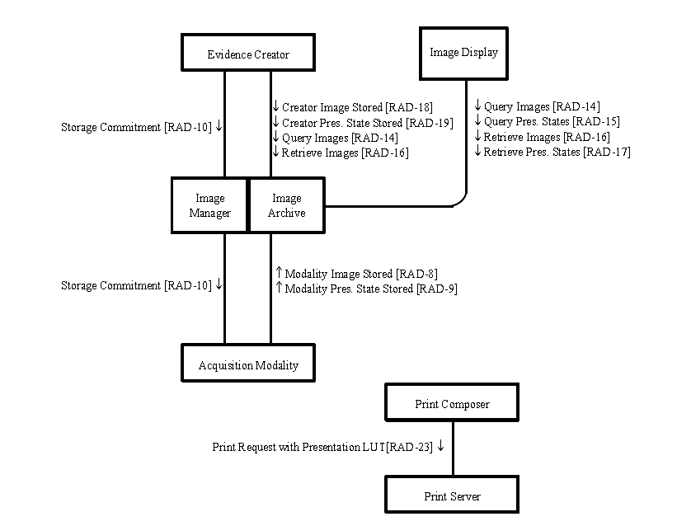
角色事务示意图

Slide 74
角色（软拷贝）
Acquisition Modality:影像设备，保存图像及显示状态（ Presentation State ）到IM
Evidence Creator：后处理工作站，产生并保存Presentation State到IM
Image Manager/ Image Archive:影像服务器，接收并管理图像及显示状态
Image Display：能利用用Presentation State显示影像

Slide 75
角色（硬拷贝）
Print Composer：胶片打印工作站，发送影像及显示状态（ Presentation State ）给胶片打印服务器
Print Server：胶片打印服务器（胶片打印机），打印时能显示状态（ Presentation State ）生成胶片

Slide 76
关于显示状态(Pres. State)
Grayscale Softcopy Presentation State
(GSPS 重点)
Color Softcopy Presentation State
Pseudo-Color Softcopy Presentation State
Blending Softcopy Presentation State
GSPS对象的Study Instance UID与图像一致，Modality值为PR

Slide 77
CPI 技术实现
生成GSPS并保存对象：Modality、EC、Print Composer
解析并应用GSPS对象显示图像：ID、Print Server

Slide 78
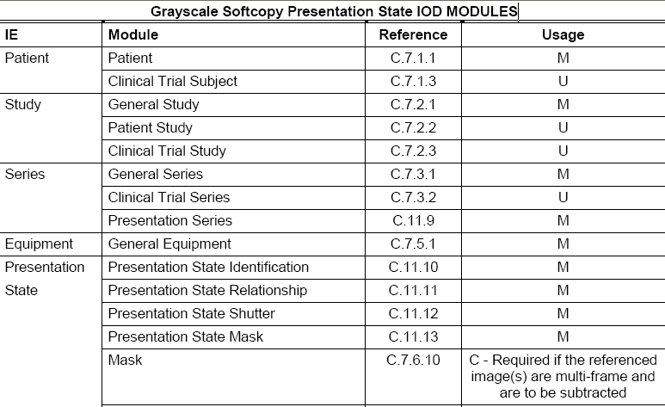
GSPS IOD（1）

Slide 79
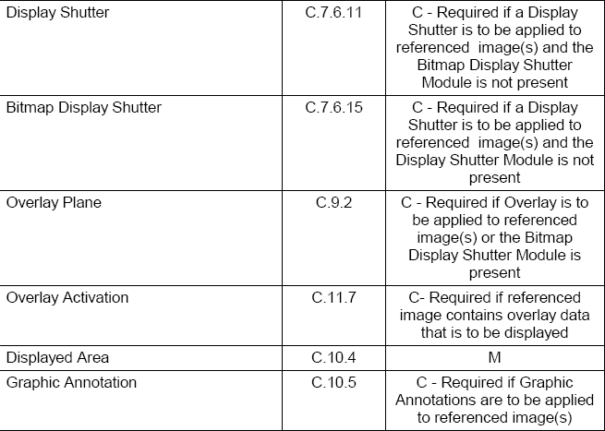
GSPS IOD（2）

Slide 80
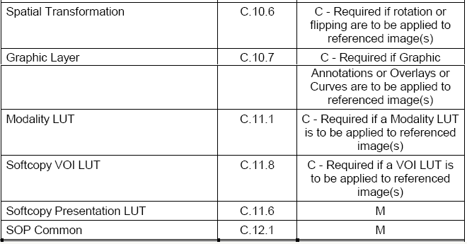
GSPS IOD（3）
http://www.dabsoft.ch/dicom/3/A.33.1/

Slide 81
GSPS IOD 说明（1）
Presentation State Identification：创建时间、说明标题等
Presentation State Relationship ：关联的图像，序列-图像-帧，可关联多个图像
Mask ：剪影显示
Display Shutter ：遮罩显示（矩形、椭圆、多边形）
Bitmap Display Shutter ：用位图指定任意遮罩图形

Slide 82
GSPS IOD 说明（2）
Overlay Plane：图像覆盖 （定位线等）
Overlay Activation :图像覆盖显示层
Displayed Area ：显示区域（适合窗口、原大显示、缩放显示）
Graphic Annotation ：文字标注或图形标注：点、折线、圆形、椭圆等
Spatial Transformation ：旋转：0, 90,180,270 ，翻转：Y = yes, N = no
Graphic Layer ：指定需要标注显示的层

Slide 83
GSPS IOD 说明（3）
Modality LUT ：对照表或者Rescale Intercept +Rescale Slope
Softcopy VOI LUT ：对照表或者Window Centers and Widths，直线或曲线(sigmoid)
Softcopy Presentation LUT ：对照表或INVERSE（反片） ，常用于保存对照表曲线

Slide 84
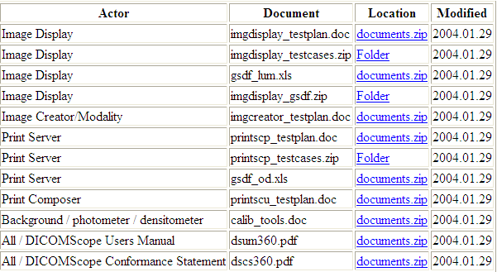
CPI自测工具
http://ihedoc.wustl.edu/mesasoftware/12.x/display_consistency/index.html

Slide 85
CPI含义
Consistent Presentation of Images(图像显示一致性）
保证诊断图像在影像设备、影像后处理工作站、影像阅片工作站上的一致性显示
保证胶片打印的一致性显示
DICOM图像显示不同于一般图像显示，如BMP、JPEG等，灰度图像DICOM像素代表的是影像设备的测量值，非最终显示图像灰度，需要指定显示参数，才能正确显示、一致性显示

Slide 86
显示一致（软拷贝）
Softcopy
Presentation State
Area Of
Interest
Area Of
Interest
Annotate
With
Consistent Presentation
Zoom
Flip
Without
Consistent Presentation
Window Level
Original Image
Notes:
86

Slide 87
显示一致（硬拷贝）
Print Composer
Print Request
With Presentation State
Hardcopy
Original Image
Print Server
Printer Status
Printed Image
Notes:
87

Slide 88
角色事务示意图

Slide 89
角色（软拷贝）
Acquisition Modality:影像设备，保存图像及显示状态（ Presentation State ）到IM
Evidence Creator：后处理工作站，产生并保存Presentation State到IM
Image Manager/ Image Archive:影像服务器，接收并管理图像及显示状态
Image Display：能利用用Presentation State显示影像

Slide 90
角色（硬拷贝）
Print Composer：胶片打印工作站，发送影像及显示状态（ Presentation State ）给胶片打印服务器
Print Server：胶片打印服务器（胶片打印机），打印时能显示状态（ Presentation State ）生成胶片

Slide 91
关于显示状态(Pres. State)
Grayscale Softcopy Presentation State
(GSPS 重点)
Color Softcopy Presentation State
Pseudo-Color Softcopy Presentation State
Blending Softcopy Presentation State
GSPS对象的Study Instance UID与图像一致，Modality值为PR

Slide 92
CPI 技术实现
生成GSPS并保存对象：Modality、EC、Print Composer
解析并应用GSPS对象显示图像：ID、Print Server

Slide 93
GSPS IOD（1）

Slide 94
GSPS IOD（2）

Slide 95
GSPS IOD（3）
http://www.dabsoft.ch/dicom/3/A.33.1/

Slide 96
GSPS IOD 说明（1）
Presentation State Identification：创建时间、说明标题等
Presentation State Relationship ：关联的图像，序列-图像-帧，可关联多个图像
Mask ：剪影显示
Display Shutter ：遮罩显示（矩形、椭圆、多边形）
Bitmap Display Shutter ：用位图指定任意遮罩图形

Slide 97
GSPS IOD 说明（2）
Overlay Plane：图像覆盖 （定位线等）
Overlay Activation :图像覆盖显示层
Displayed Area ：显示区域（适合窗口、原大显示、缩放显示）
Graphic Annotation ：文字标注或图形标注：点、折线、圆形、椭圆等
Spatial Transformation ：旋转：0, 90,180,270 ，翻转：Y = yes, N = no
Graphic Layer ：指定需要标注显示的层

Slide 98
GSPS IOD 说明（3）
Modality LUT ：对照表或者Rescale Intercept +Rescale Slope
Softcopy VOI LUT ：对照表或者Window Centers and Widths，直线或曲线(sigmoid)
Softcopy Presentation LUT ：对照表或INVERSE（反片） ，常用于保存对照表曲线

Slide 99
CPI自测工具
http://ihedoc.wustl.edu/mesasoftware/12.x/display_consistency/index.html

Slide 100
PDI – 可移动图像数据
规定如何将图像数据通过介质进行交换
规定介质内容的结构
规定所使用的协议（DICOM）

Slide 101
Distributed Imaging Information
On Media [RAD-47]
Display
Distributed Imaging Information
On Media [RAD-47]
Image
Display
Distributed Imaging Information
On Media [RAD-47]
Report
Reader
Distributed Imaging Information
On Media [RAD-47]
Print
Composer
Portable
Media
Creator
Distributed Imaging Information
On Media [RAD-47]
Portable
Media
Importer

Slide 102
PDI – 角色
Portable Media Creator：收集图像及相关信息，并将之写入移动介质
Display：读取并显示介质的Web内容
Image Display：读取并显示介质的图像信息
Portable Media Importer：读取介质中的内容并将之导入到本地系统中，并与本地信息进行一致性处理
Report Reader：读取介质中的报告内容
Print Composer：打印介质的内容

Slide 103
PDI – 事务
RAD-47 － 通过介质发布图像信息
介质的文件系统和文件命名规则
介质目录结构

Slide 104
PDI – 目录结构
DICOMDIR
DICOM内容
DICOM图像信息文件夹
介质的入口点
INDEX.HTM
README.TXT
WEB内容
IHE_PDI
Other directories
其它内容
Other files

Slide 105
PDI – DICOM内容
DICOMDIR：必须位于根目录下，包含对介质上所有DICOM图像的引用
DICOM图像：不能位于根目录下,只能位于某个子文件夹下,文件夹名字不受限制
README.TXT：推荐有，即使没有WEB内容

Slide 106
PDI – WEB内容
INDEX.HTM：位于根目录下，包含对介质上所有可显示在WEB上的信息的引用
公司信息
公司对介质上的信息的所有权和安全信息的声明
对IHE_PDI文件夹下的内容的链接
对README.TXT文件的链接
可以被导出的DICOM信息的列表（通过Portable Media Importer实现）
和患者相关的信息的列表，这些信息不能被导出
对DICOM浏览器的链接，点击此链接可以打开DICOM浏览器

Slide 107
PDI – WEB内容
README.TXT：位于根目录下，包含需要让客户知道的信息
公司的联系方式
生成介质的系统信息
对介质上所有内容的介绍
DICOM浏览器的相关信息，包括：
支持的操作系统
浏览器的产品名字和版本号
开发浏览器的公司的联系方式
版权信息
系统需求列表
和使用系统相关的其它信息

Slide 108
PDI – WEB内容
IHE_PDI：必须位于根目录下，包含以下内容
从DICOM信息对象衍生出的，可以在WEB上浏览的对象，如XHTML, JPEG, PNG, GIF等
在WEB上显示的如实反映患者临床信息内容
一些限制：
除了上述内容，IHE_PDI中不允许再放其它内容
IHE_PDI可以再有子文件夹

Slide 109
PDI – 文件系统命名规则
文件内容遵守DICOM规定和ISO 9660一级规定
DICOMDIR中引用的文件夹和文件名字不能超过8个字符
文件名必须大写
只能包含字母，数字和下划线
不能有扩展名
非DICOM数据不受以上规则限制,但是必须遵守ISO 9660-1

Slide 110
PDI – 其他信息
除了DICOM信息和WEB信息外，其它任 何信息均可放在介质中，但是需要遵循上面的规则
任何附加的文件夹不能以“IHE”开头
不推荐将附加文件放在根目录下

Slide 111
Actors | Transactions
Portable Media Creator | Distribute Imaging Information On Media [RAD-47]
Portable Media Importer | Distribute Imaging Information On Media [RAD-47]
Image Display | Distribute Imaging Information On Media [RAD-47]
Print Composer | Distribute Imaging Information On Media [RAD-47]
Report Reader | Distribute Imaging Information On Media [RAD-47]
Display (ITI TF) | Distribute Imaging Information On Media [RAD-47]

Slide 112
谢 谢

